Slide 1

Milestone 2
Team 8
Qi qi, Isaac, gideon

Slide 2


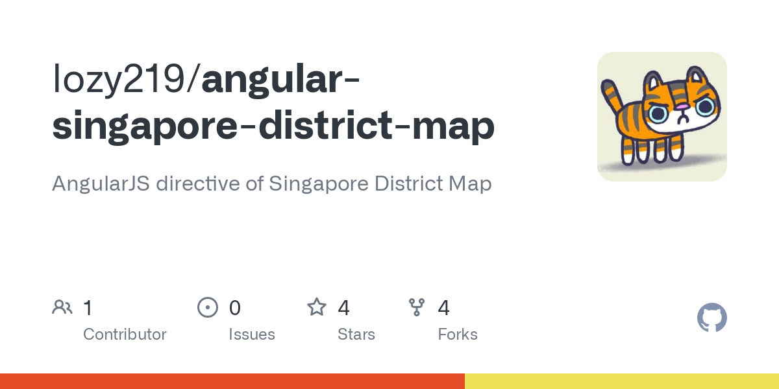

What (data)

Slide 3
Why (Task)
To give new investors a gentle introduction to the residential property market in Singapore
To show the possible key driving factors behind property prices in Singapore

Slide 4
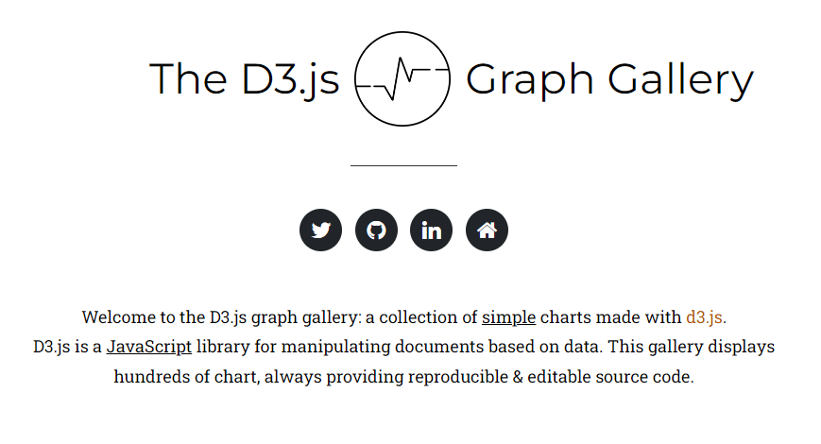
how (idioms)
Choropleth Map
Circular Packing (1 layer)
Arc Diagram
Percent Stacked Bar
Line Chart
Faceted Stacked Bar
Faceted Line Chart

Slide 5



Technologies used

Slide 6
Pitfalls encountered
Difficulties in obtaining property sales data as there is no one centralised data source
Data was raw and needed to be cleaned and pre-processed to fit to certain chart

Slide 7
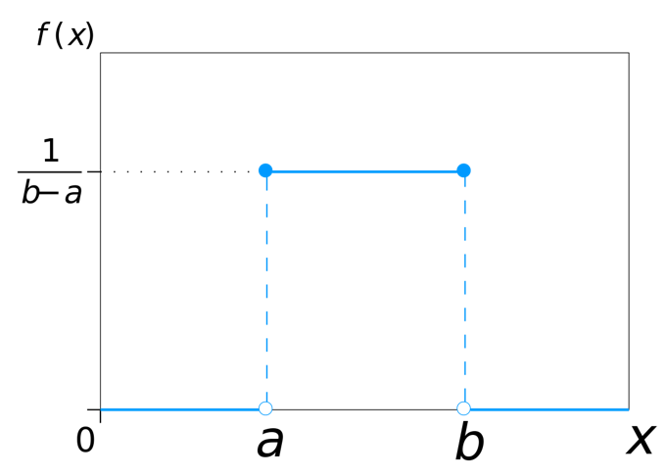
WORKLOAD Distribution

Slide 8

Storytelling web demo

